Slide 1



E-COMMERCE
CONCEPTS AND PLATFORMS

Slide 2


OVERVIEW OF E-COMMERCE

Slide 3


What is e-Commerce?
Please choose one of these following answer
1. e-Commerce is the sale or purchase of goods or services, conducted over computer networks by methods specifically designed for the purpose of receiving or placing orders.
2. e-Commerce encompasses the digital processes of marketing, selling, and distributing products or services through electronic channels.
3. e-Commerce involves online transactions and commercial activities conducted between businesses or individuals.
4. e-Commerce is the electronic exchange of products or services conducted through online platforms.

Slide 4

DEFINITION OF
E-COMMERCE
An e-Commerce transaction is the sale or purchase of goods or services, conducted over computer networks by methods specifically designed for the purpose of receiving or placing orders. The goods or services are ordered by those methods, but the payment and the ultimate delivery of the goods or services do not have to be conducted online. An e-Commerce transaction can be between enterprises, households, individuals, governments, and other public or private organizations.
OECD, 2011
DREAMTIMES.COM

Slide 5


SUCCESSFUL CASE STUDY
FREE SHIPPING AND RETURNS
BOOKS
LOW PRICES
FAST DELIVERY
VAST PRODUCT SELECTION
$54M
1997
EXEPTIONAL CUSTOMER SERVICE
1994
OVERNIGHT DELIVERY
COMPETENT MANAGEMENT

Slide 6

DIGITAL TRADE
While there is no single recognized and accepted definition of digital trade, there is a growing consensus that it encompasses digitally enabled transactions of trade in goods and services that can either be digitally or physically delivered, and that involve consumers, firms, and governments. That is, while all forms of digital trade are enabled by digital technologies, not all digital trade is digitally delivered. For instance, digital trade also involves digitally enabled but physically delivered trade in goods and services such as the purchase of a book through an on-line marketplace or booking a stay in an apartment through a matching application

Slide 7
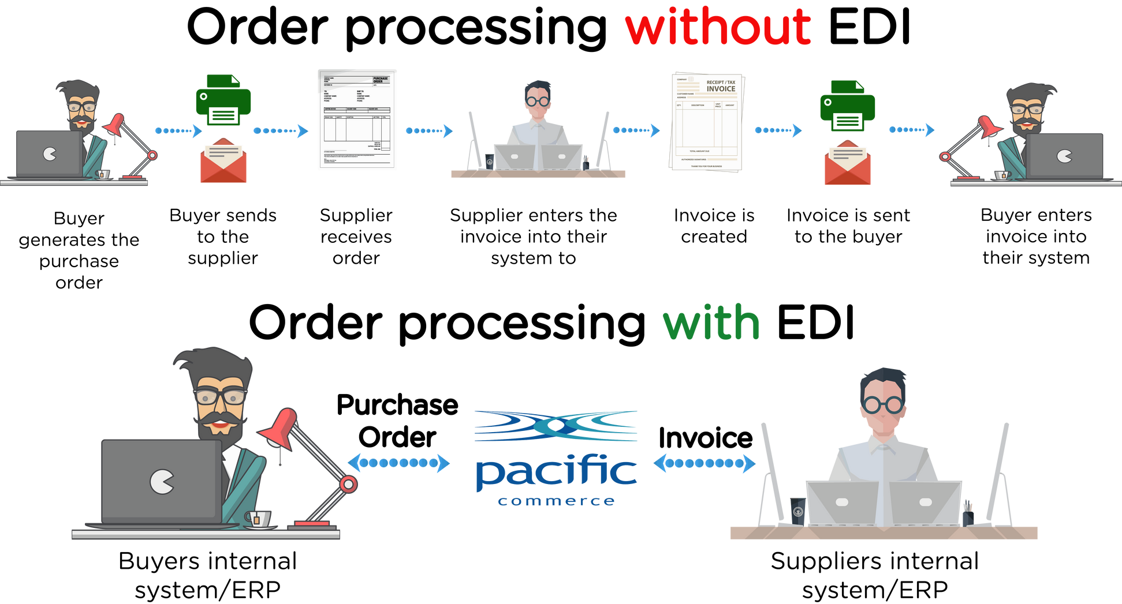

ELECTRONIC DATA EXCHANGE
DEFINITION
Electronic exchange of data usually in forms that are compatible so that software or a combination of individuals and software can put it in a compatible form at the receiving end if necessary.
PACIFICCOMMERCE.COM.AU
ADVANTAGES
  The paper usage reduced.
  Improved quality of data.
  Speed Increases.
  Security.
  Information accuracy.
  Less Cost

Slide 8
INTERNATIONAL ACCESS
DEFINITION
Digital infrastructure is global and therefore trade has the potential to be conducted internationally thereby passing physical limitations
ADVANTAGES
  Increased Revenues
  Decreased Competition
  Longer Product Lifespan
  Easier Cash-Flow Management
  Better Risk Management
  Benefiting from Currency Exchange
  Access to Export Financing
  Disposal of Surplus Goods
  Enhanced Reputation
  Opportunity to Specialize

Slide 9

DEFINITIONS
TRADITIONAL COMMERCE
e-COMMERCE
DOMESTICS
PRODUCTS
PRODUCTS
A consumer purchases products from a physical retailer store.
A consumer purchases products from an online domestic store.
SERVICES
SERVICES
The services received by the consumers doesnt require them to be online.
The services received by the consumers doesnt require them to be online.
INTERNATIONAL
PRODUCTS
PRODUCTS
Companies have complete control over the export and import products across geographical boundaries.
A consumer places an order from an online e-commerce store and the products are shipped to the consumer from another country.
SERVICES
SERVICES
Provisions of services that dont rely on digital infrastructure.
Services are provided cross-border and provision of services which transcend terrestial boundaries.

Slide 10
ADVANTAGES
TRADITIONAL COMMERCE
E-COMMERCE
  Suitable for perishables and “touch and feel” items.
  Easy access to human resources and skills development.
  Face-to-face interaction.
  Limited exposure to cyber security threats.
  Cost effective.
  Faster transaction and better connectivity.
  Access to international value chains.
  Potential to tap into larger consumer base.
  Instantaneous/ very quick product feedback.
  Available 24x7

Slide 11
E-COMMERCE STAKEHOLDERS
DEFINITION
A stakeholder can be defined as a person, group or institution that has a vested interest or concern in particular organizations. Stakeholders can affect or be affected by the organization's actions, objectives and policies.
TYPES OF STAKEHOLDERS
  E-Commerce Platforms/Marketplaces.
  Vendors.
  Consumers/Buyers.
  Financial Intermediaries and e-Payment Service Providers.
  Freight Forwarders and Logistics Service Providers.
  Customs Brokers.
  Express Carriers.
  Fulfilment houses/centres.
  Postal Operators.

Slide 12


The e-Commerce space is becoming more crowded. e-Commerce incumbents and new entrants are racing to gain consumers' attention. The result is increased costs of advertising and reduced return on ad spend (ROAS).
In 2021, retail e-commerce sales amounted to approximately 5.2 trillion U.S. dollars worldwide. This figure is forecast to grow by 56 percent over the next years, reaching about 8.1 trillion dollars by 2026.
MORE COMPETITIVE

Slide 13
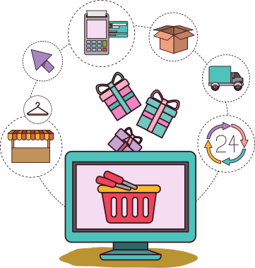
GO GLOBAL
Total addressable market (TAM) is a common limiting factor of growth. As businesses reach their growth limits in the domestic environment, the world will see more e-Commerce brands expand into the global stage.
The go-global movement is echoed by consumers. In fact, a recent survey revealed that 76% of online shoppers have made purchases on a site outside their own countries.
CANVA.COM

Slide 14

INFLUENCER MARKETING
Influencer marketing refers to the practice whereby organizations and brands partner with selected influencers on social media to create and/or promote branded content, thus targeting both the influencers’ followers and the brands’ target audience.
Influencer marketing can reportedly deliver a ten-fold higher Return on Investment (ROI) than traditional forms of digital marketing.
DREAMTIMES.COM

Slide 15
LATEST TREND IN ASEAN
GLOBAL E-COMMERCE SALES SURPASSED $1.6 TRILLION IN 2018 AND ARE ANTICIPATED TO REACH $2.7 TRILLION BY 2023.
Together with China and India, i.e. through free trade and market integration, the area might be part of the global e-Commerce epicenter by 2023, accounting for more than 40% of the global e-Commerce market.
It is anticipated that the average growth rate of e-Commerce in ASEAN member states will exceed 10% every year.
By 2025, the e-Commerce business will be worth more than $100 billion
FROM 2018 TO 2023, ASEAN'S TOTAL E-COMMERCE INCOME WILL CLIMB BY ABOUT 200%.
THE REGIONAL E-COMMERCE MARKET IS ANTICIPATED TO INCREASE AT A RATE OF 25–35% PER YEAR OVER THE NEXT 5–10 YEARS.

Slide 16
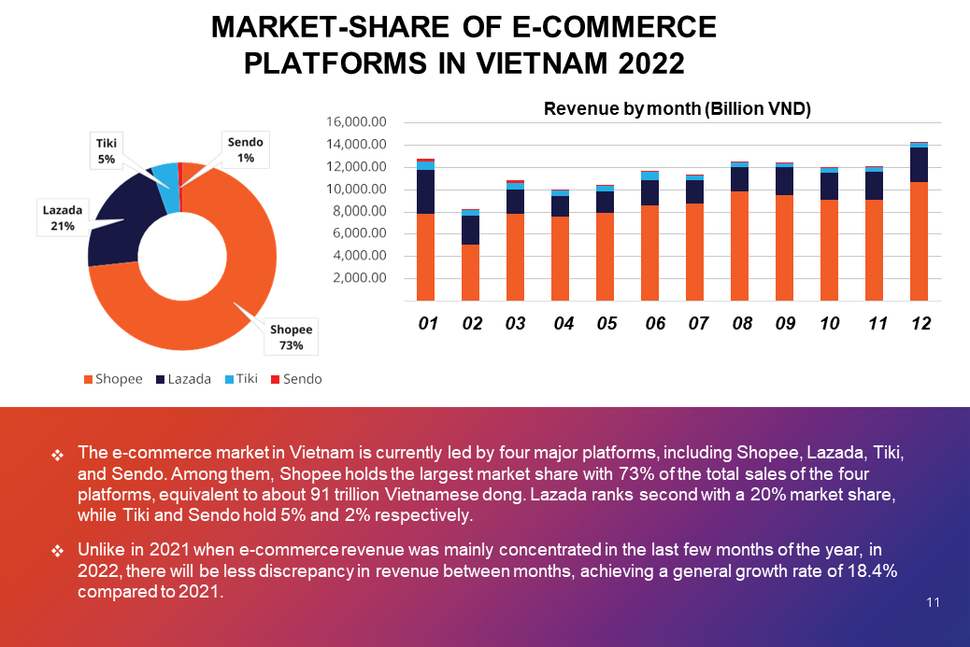
LATEST TREND IN [COUNTRY]
METRIC.VN

Slide 17
E-COMMERCE BUSINESS MODELS AND STRATEGIES

Slide 18
e-Commerce Business Models
What is the type of partner you would like to do business with?
1. Consumers
2. Companies
3. Government agencies

Slide 19
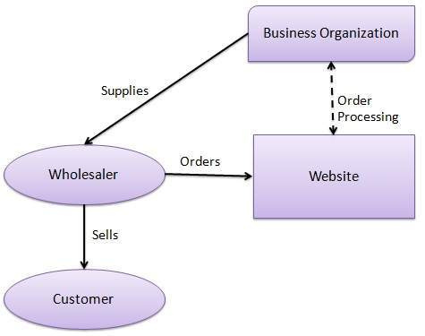
BUSINESS TO BUSINESS (B2B)
EXAMPLES?
B2B e-commerce: a business supplies its products to an intermediate buyer, which will proceed to sell the products to the final customer. In the illustration:
  A wholesaler places an order from a company's website.
  Company processes the consignment and supply the end-product(s) to wholesaler.
  The wholesaler sells the product(s) to the final customer(s) through their retail outlet.
EMERGEAPP.NET

Slide 20
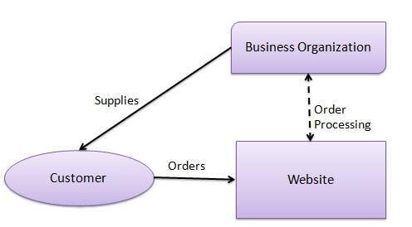
BUSINESS TO CONSUMER (B2C)
EXAMPLES?
B2C e-commerce involves direct interaction between business and consumer through an e-commerce platform. In the B2C illustration:
  Consumers visit the enterprises website and orders products.
  The enterprise is notified of the order.
EMERGEAPP.NET

Slide 21
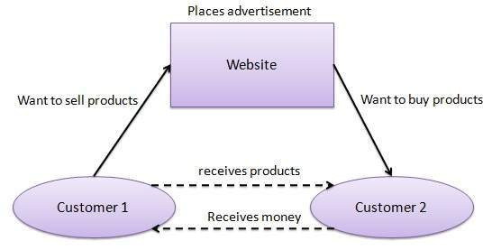
CONSUMER TO CONSUMER (C2C)
EXAMPLES?
C2C e-commerce is a business model that facilitates an environment, usually online, where customers can trade with each other via a third-party platform. C2C platforms make their profits from: fees charged to sellers when listing items for sale and digital payment methods.
EMERGEAPP.NET

Slide 22
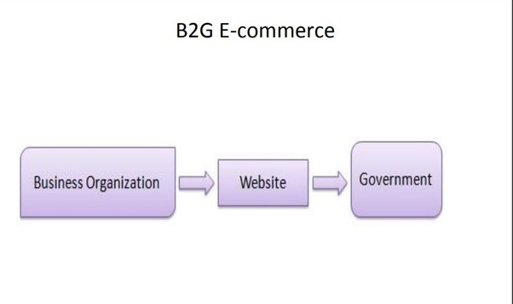
BUSINESS TO GOVERNMENT (B2G)
Business to Government (B2G) is a business model that facilitates trade activities between enterprises and governments. B2G is based around two presuppositions:
  The public sector takes a leading role in establishing e-Commerce.
  The public sector has the greatest need for making the procurement system more effective.
EXAMPLES?
EMERGEAPP.NET

Slide 23






M-commerce involves engagement with e-commerce platforms through hand-held and wireless devices such as smartphones and tablets. Analysis of consumer mobile activity – such as browsing tendencies provides manufacturers the ability to tailor their products and services
LARGE CUSTOMER BASE
OMNI CHANNELS
More widely and easily accessible.
Reach to customers via many touch points
M-COMMERCE
AUTOMATION
CONVENIENCE
Automates with mobile contactless payment options.
Easier to compare prices, read reviews and make purchases anywhere, anytime.

Slide 24
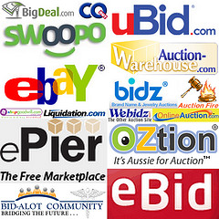
ONLINE AUCTIONS
Online auctions serve as platforms for both businesses and individuals to engage in B2B and B2C e-commerce.
These auctions handle various aspects such as website design, providing product information, and facilitating online payments, typically charging a fee to list products. Different auction sites have varying buying and selling processes, so it is essential for enterprises to familiarize themselves with these techniques by visiting and analyzing these platforms.

Slide 25
REVERSE AUCTIONS
DEFINITION
A reverse auction is a type of auction in which the role of the buyer and seller are reversed (i.e. the buyer elicits offers from the seller).
The objective of this model is to lower the price of the products and/or services as low as possible. Services and products offered on these platforms have as much detail presented a possible to ensure bidding process is smooth as possible. Prices in a reverse auction decrease as potential buyer aims to underbid each other.
ADVANTAGES
  Reduced negotiation times
  Short procurement cycles
  Increased transparency for competing bids.

Slide 26
WEBPAGE DESIGN STRATEGIES
e-Commerce has a strong dependence on the Internet and the World Wide Web (www). www is an interactive document (webpage), hosted on many Internet servers. Enterprises can develop and design webpages which can be shared with consumers and other platforms to increase their sales.
INFORMATION AND COMMUNICATION
ONLINE AND TRANSACTIONAL DESIGN
  Provision of comprehensive information.
  Increase Global Presence.
  Efficient communication channel to build relationships with customer
  Larger selection or specialized products/services available to customers.
  Builds a communal relationship among customers

Slide 27
INFORMATION AND COMMUNICATION STRATEGY (1)
This approach enables companies to use the Web as a platform to provide supplementary services in addition to their traditional marketing channels. Usually, it could be a B2B website of a service provider.
Associated Promotion Methods:
  Online cataloging of products/services.
  Increase brand image.
  Utilize the Web as a cost effective to promote products.
  Automation of routine customer services.

Slide 28
INFORMATION AND COMMUNICATION STRATEGY (2)
4 design models of Information and Communication Strategy which can be adapted if an informational and communication design strategy is employed:
  Brand Awareness and Image Building Model: Users have in-depth access to detailed information about the services offered by enterprises.
  Cost Savings Model: The reduction of commercial based activity and meeting customer requirements – helps a website be more cost effective and productive.
  Promotion Model: The main objective of this model is to attract users to the commercial website through advertisements.
  Info-Mediated Model: This model provides free access to the Internet and/or hardware in exchange for information on a customer’s surfing and purchasing habits

Slide 29
ONLINE AND TRANSACTIONAL DESIGN STRATEGY (1)
This approach enables companies to use the Web to construct an online-business which is independent & profitable – existing only in the cloud. Usually, it could be a B2C website of a goods supplier.
Associated Promotion Methods:
  Increasing presence beyond retail stores.
  Provision of unique information to customers.
  Promoting specialized products/services.

Slide 30
ONLINE AND TRANSACTIONAL DESIGN STRATEGY (2)
8 design models of Information and Communication Strategy which can be adapted if an online and transactional design strategy is employed:
  Brokerage Model: Brokers bring buyers and sellers together.
  Retail Model: E-tailers are the digital equivalent of wholesalers and retailers.
  Mall Model: A digital mall can be a host to many enterprises’ products.
  Advertising Model: Provides a combination of content, services, and adverts.
  Subscription Model: Consumers pay a fee to gain access to the website.
  Community Model: Promoting advertising opportunities and specialized services to highly invested customers.
  Manufacturer Model: Directly connect the manufacturer and customers.
  Customization Model: Providing custom based information to consumers.

Slide 31
USING
E-COMMERCE PLATFORM

Slide 32
Using e-Commerce platform
Have you ever use an e-Commerce platform for you business?
55%
Using e-Commerce platform
35%
As buyers/ As sellers
7/10
Average Difficulty

Slide 33
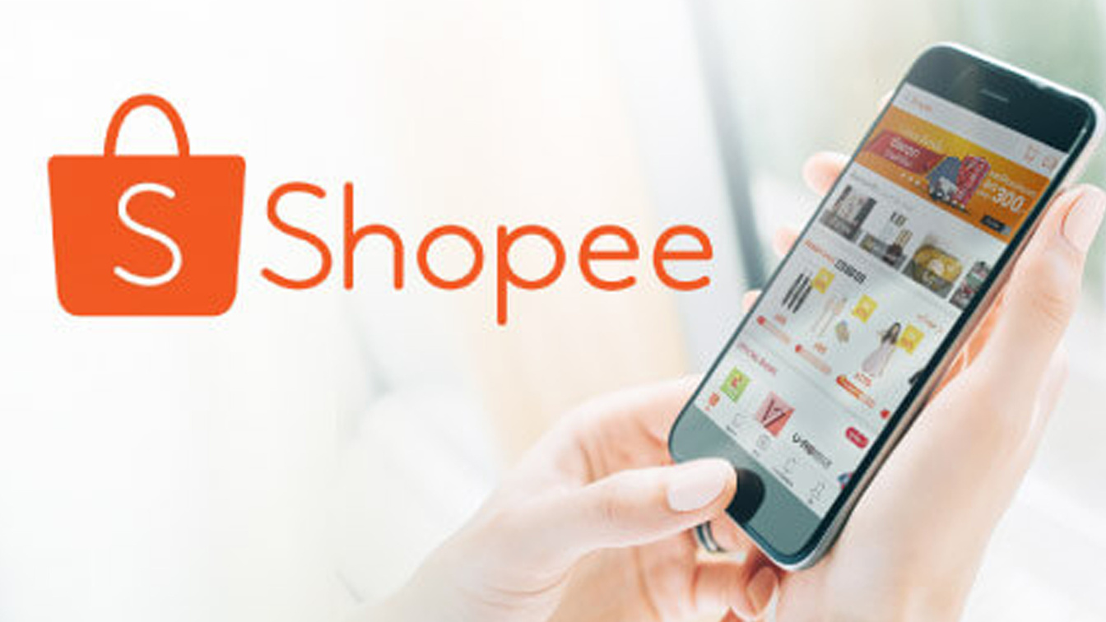
SHOPEE
Singapore-based Shopee is a chain of eCommerce websites with 15 major sites for Asian, European, American markets.
Shoppe’s combined GMV for all markets reached 60 billion USD in 2021, staggering 80% growth from the 2020. In the 2009, Shopee stole the crown from its biggest rival and now is the e-Commerce leader in the region
Active in: Singapore (Head quarter), Indonesia, Vietnam, Thailand, Malaysia, Philippines.
Yearly GMV: 60 billion USD.
Monthly visits: 470 million.
Employees: 20.000.

Slide 34

LAZADA
Recently beaten to the top spot by Tencent-backed Shopee, Lazada still represents a formidable presence in the region.
The platform, which was introduced in 2012, now has 3,000 brands and more than 155,000 local and foreign retailers servicing the region's 560 million people. Lazada has a huge selection of goods with over 300 million SKUs
Active in: Singapore (Head quarter), Indonesia, Vietnam, Thailand, Malaysia, Philippines.
Yearly GMV: 40 billion USD.
Monthly visits: 140 million.
Employees: 10.000.

Slide 35

CAROUSELL
Three Singaporean students returned from an internship in Silicon Valley in 2012 inspired to develop Carousell, a platform to sell used electronics and tech. It now sells a range of products and uses C2C and B2C models.
Active in: Singapore (Head quarter), Indonesia, Malaysia, Philippines.
Yearly GMV: N/A.
Monthly visits: 21 million.
Employees: 500.

Slide 36
HOW TO REGISTER ON SHOPEE
PREPARATION
To create a Shopee account, users need:
  A phone number or a Facebook/ Google account
  A device which is connected to the internet.
  Carefully read Shopee’s Terms of Service and Privacy Policy.
Sign up via Shopee App
Go to the Me tab via Shopee App > Sign Up > Enter a locally registered Phone Number > Next > Enter captcha Code > Enter Verification Code > Set Password > Sign Up to complete.
Sign up via Shopee Website
Select Sign Up on Shopee website > Enter Phone Number > Complete Verification puzzle > Enter Verification Code > Set Password > Sign Up to complete.

Slide 37

E-PAYMENT POLICIES OF SHOPPEE
FEES FOR LOCAL SELLERS
10 PAYMENT OPTIONS
1. Transaction fee: 2-2.12%
2. Marketplace Commission fee (>=100 orders): 2-4.24%
3. Marketplace Commission fee (<100 orders): 0%
4. Shopee Mall Commission fee: 4-6.36%
5. Marketing Programme Service fee: 4-7.42%
1. Payment at stores
2. ShopeePay
3. Credit / Debit Cards
4. Installment Plan
5. Cash-on-delivery (COD)
6. SPayLater
7. Maybank2u
8. Google Pay
9. Online Banking
10. Apple Pay

Slide 38
MANAGE ORDERS ON SHOPPEE
SELLER CENTRE
SHOPEE APP
Sellers can view your orders under the My Shipment page. Orders that require shipping arrangements can be viewed under the To Ship tab. These orders consist of both processed and unprocessed orders.
Processed orders: Orders that have shipment arranged but are yet to be picked up or dropped off by logistics providers.
The Arrange Shipment icon will redirect you to the shipping options (drop-off or pick-up) to process the orders.
Sellers can view the orders that require shipping arrangement using the To Ship icon. Next, the Arrange Shipment icon will redirect to the shipping options (drop-off or pick-up) to process the orders.

Slide 39
AFTERSALES MECHANISM
Aftersales mechanisms typically include features such as customer service center, product returns, refunds, and exchanges. These mechanisms are designed to ensure that customers are satisfied with their purchases and are willing to make future purchases from the platform.
Additionally, e-Commerce platforms often collect data on customer behavior and preferences through their aftersales mechanisms, which can be used to improve product offerings and marketing strategies.
DISPUTE RESOLUTION CENTRE
RETURN, REFUND, EXCHANGE
RATINGS AND REVIEWS

Slide 40
DISPUTES
There are a lot of disputes between the stakeholders when the transaction is completed:
FROM SELLERS
FROM BUYERS
FROM LOGISTICS SUPPLIERS
  Send the wrong / damaged / faulty products.
  Send the incomplete items or not enough amount as ordered.
  Buyers refuse to receive.
  Cannot connect to buyers as described contact information.
  Missing items.
  Damaged items/ Damaged beyond return.
  Deliver to the wrong person.

Slide 41
DISPUTE RESOLUTION CENTRE
Shopee offers a Dispute Resolution Centre, which is a feature on Shopee App that lets buyers open a discussion with sellers for orders that buyers wish to return/refund.
At Dispute Resolution Centre, the buyers and sellers may:
  EXCHANGE MESSAGES
  PROPOSE OR COUNTER-PROPOSE A SUITABLE REFUND AMOUNT OR SOLUTION.
  RAISE A REQUEST FOR RETURN AND REFUND.
Upon receiving a dispute request, Shopee will investigate the case and come to a fair resolution. This will take around 5 working days, which may be subjected to changes depending on the reason for return/refund.

Slide 42
DISPUTE RESOLUTION CENTRE
The return and refund regulations of Shopee in case of:
  INCOMPLETE PRODUCTS/MISSING ITEMS/ COUNTERFEIT PRODUCTS
Shopee approves the request for a refund only within 5 working days.
A dispute can be raised if the returned products are deemed unsuitable for refund. Shopee will reject the request if the buyer’s initial supporting evidence is invalid or does not support the return/refund reasons.
  DAMAGED/ FAULTY/ WRONG PRODUCTS
Returned products will be shipped to the seller/ Shopee Warehouse. If the products do not meet the return criteria, the seller/ Shopee Warehouse may raise a dispute.

Slide 43
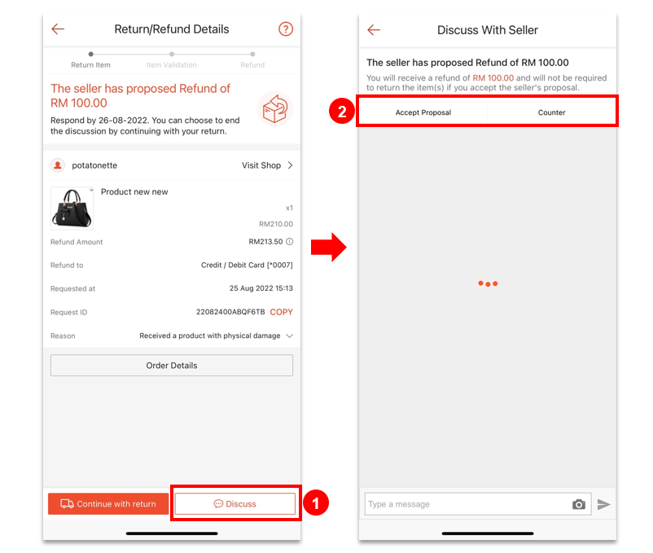
REFUND POLICIES OF SHOPEE
  Shopee refunds the buyers to their Shopee Pay account or by Shopee Coins.
  A voucher which is used for an order will be refunded if your return/refund request has been approved for a full refund.
  When the buyers receive a partial refund proposal from a seller, you can choose to accept, negotiate or reject the proposal, within 1 day.

Slide 44
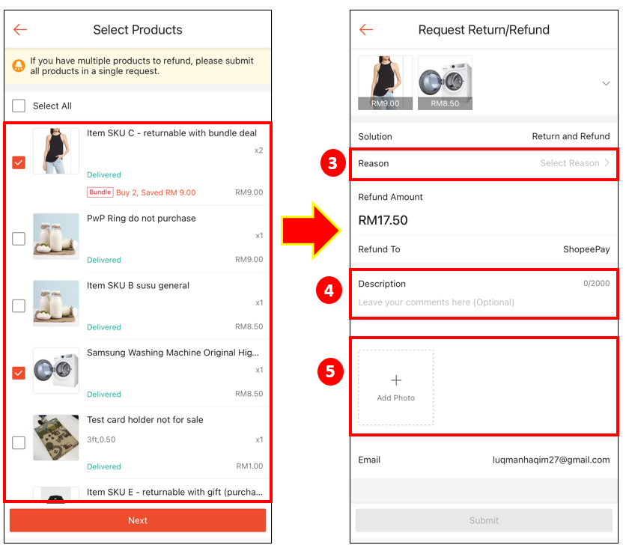
RETURN POLICIES OF SHOPEE
Return reasons:
  Did not receive the order.
  Received an incomplete product.
  Received the wrong product(s).
  Received a product with physical damage.
  Received a faulty product.
  Received a counterfeit product.
Evidence submission:
  Photos and/or videos showing product errors or defects (for damaged/faulty products).
  Photos of parcel’s internal and external packaging.

Slide 45
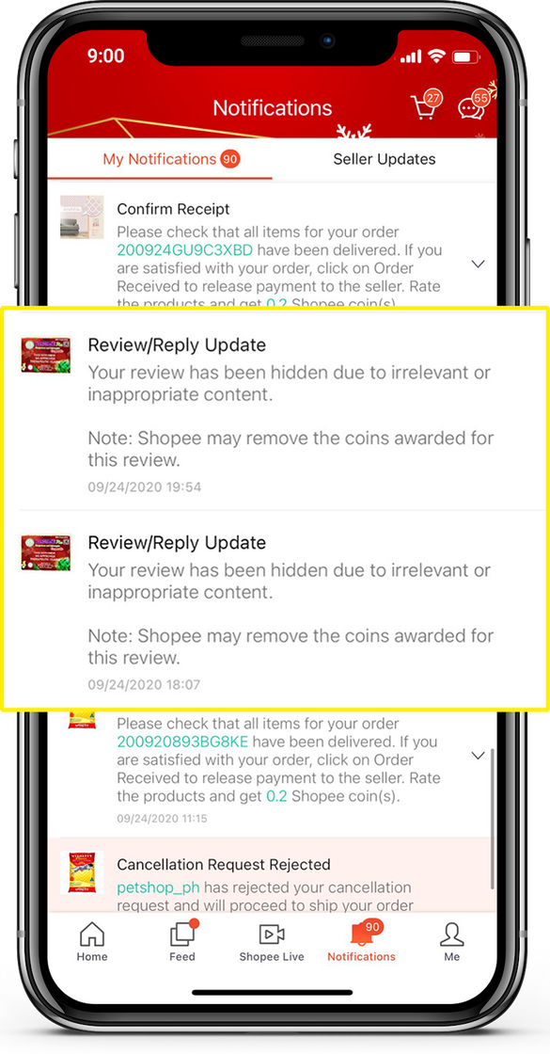
RATINGS AND REVIEWS
Shopee allows buyers to rate and review products after receiving the goods in order to provide useful information and help other shoppers make a purchase decision.
Each quality review is rewarded and Shopee removes product reviews that contain text, images or videos that are:
  Abusive, vulgar or otherwise objectionable.
  Not relevant to the product or the service provided by the seller.
The buyers can rate and review a product or a specific order. A rating or review could be edited once within 30 days of submitting the initial rating.

Slide 46
THANK YOU!

