Slide 1






Fundraising Practice
FF-201
PICHMONITA HO, CAMBODIA

Slide 2
MODULE 1.
FINANCING YOUR BUSINESS
Notes:
Each module should be divided by a module title page.

Slide 3
1.1 What is Financing?
the process of providing funds for business activities, making purchases, or investing.
a way to leverage the time value of money to put future expected money flows to use for projects started today.
Notes:
We suggest less than 8 core contents for each module.
Each content page can be composed of 3 – 6 bullet points, a figure / figures, or a mix of a figure and bullet points.

Slide 4
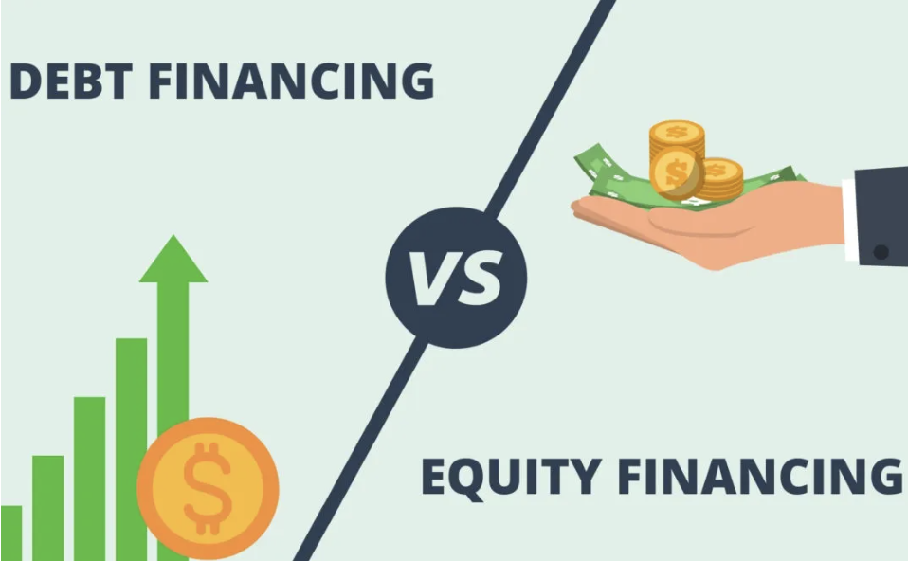
  Debt financing: is when a business takes out loans from banks or other lenders.
Equity financing: is when a business sells ownership stakes to investors in exchange for capital.

Slide 5
[Activity] Think-Pair-Share
Form groups
Pros and Cons of Debt financing and Equity Financing

Slide 6

Type of business and their life cycles
Every business is different so as their life cycles and financing requirements.
In every business:
  the startup phase
  the growing phase
  the mature phase

Slide 7
1.2 Startup-Phase
Financing initially comes from personal sources (often referred to as bootstrapping financing):
Personal savings
A second mortgage on the founder’s home
Credit card/ lines of credit

Slide 8
In this phase, you may also start to seek for the outside resources or seed investment:
  Loans from friends/relatives
  Bank loan from small banks and online lenders
  Short-term trade credit from suppliers
  Crowdfunding
  Equity investment from an accelerator program

Slide 9
Having a track record of business success and good standing in the business or scientific community attracts investors (Angel investors, private equity, a venture capital firm…) to fund a startup.
There are some limited external sources of capital available to the startup-stage businesses known as the seed stage when your bootstrapped business starts to show some signs of success or grow.
  Trade credit
  Commercial bank loans
  Crowdfunding
  Accelerators

Slide 10
1.3 Growing phase
Most capital comes
from bank debt for
slow to moderate
growth businesses.
Business expands its sale & larger customer base
More capital is needed
can typically access external funding easier than in startup phase.

Slide 11
Various forms of capital sources during the growing phase:
  Internal cash flow from operations
  Debt capital
  Venture Capital
  Initial public offering

Slide 12
1.4 Mature phase
No longer experience rapid expansion.
Growth is still possible.
Owner may decide to keep running their business and collect dividends, or sell it since it is flourishing and more valuable.
Additional external funds can be obtained through bank loans, the sale of commercial paper, bonds, and preferred stocks.

Slide 13
Matching assets and financing:
  The assets and their associated forms of financing should be matched regardless of its financing purposes (to launch a business, support/maintain its operations, or foster growth).
  Short-term assets => to be financed with short-term financing.
  Long-term assets => to be financed with long-term or permanent financing.

Slide 14
MODULE 2.
FINANCING OPPORTUNITIES
Notes:
Each module should be divided by a module title page.

Slide 15

2.1 General funding sources for MSMEs in ASEAN
More than 200 venture capital and private equity firms, social impact investors, equity crowdfunding platforms, and angel investors spreads all over Southeast Asia.
Funding sources include:
  Angel Investors
  Venture Capital
  Social impact investors
  Equity crowdfunding

Slide 16
Angel Investors
Usually are the affluent individuals who provide capital for a business start-up, usually in exchange for convertible debt or ownership equity.
The best way to find an angel investor is frequently through the contacts you have in the business community.
There are various website online which you can reach angel investors even more effectively.

Slide 17
Venture Capital
The fund that invests in new or growing businesses in exchange for an ownership stake, and often, representation on the board of directors.
The fund is made up of investments from institutions and wealthy individuals.
Investors focus on scalability and potential returns and they have a tendency to look for larger investments than angel investors do.

Slide 18
Social Impact Investors
Business looking to address significant issues in health, education, poverty alleviation, or other social issues.
Have more flexible investment terms, which reflects the unique requirements of social enterprises.
Some of the social impact organization in the Southeast Asian market: ARUN, Anthem Asia, Gandeng Tangan, Garden Impact, IIX Growth Fund, Insitor Impact Fund, KIVA, etc

Slide 19
Equity crowdfunding
A new approach for seeking investors in a business.
Gives business owners the chance to get funding through standard mechanisms and gives retail and other investors the chance to invest in new ventures.
Investors receive equity (shares of company stock).

Slide 20
2.2 ASEAN Programme to assist MSMEs
ASEAN Coordinating Committee On Micro, Small And Medium Enterprises (ACCMSME)
ASEAN SME Service Centre
ASEAN SME Academy
ASEAN Access
ASEAN Business Advisory Council (ASEAN-BAC)
National Programs

Slide 21
[Activity] Think-Share
Participants will be asked to think of their national programs and shared their opinions on “Which national programs are aligned to ACCMSMEs?

Slide 22
MODULE 3.
ESTABLISHING A FUNDING PLAN
Notes:
Each module should be divided by a module title page.

Slide 23
3.1 Overview of business types and its suitable funding
Micro
Small
Medium

Slide 24
MSMEs Definition
based on the classifications and criteria set by each ASEAN member states:
  Sectors
  Number of Employment
  Annual turnover/total assets
  Other criteria

Slide 25
Comparing potential investors
Bootstrapping
Banks and other loans
Credit cards
Friends and Family
Angel Investors
Venture Capital
Government

Slide 26
Bootstrapping
Pros
Financial control & ownership
Creative freedom
Cons
Personal & financial risks
Limited on your visibility, growth, expansion
Flexible timelines
Fewer resources, less credibility
The practice of building a business without outside capital investment.
=> From Personal finance

Slide 27
Banks and other loans
The amount of money borrowed for a set period within an agreed repayment schedule.
Pros
Size of loans and repayment period can be organized to match firms' exact needs
Potentially favorable interest rates
No equity dilution
Cons
Strict eligible criteria (Collateral requirements…)
Risk of seizing, losing assets
High interest rates
Complicated application procedures

Slide 28

Credit cards
Pros
Earning rewards
Building credits history
Cons
Paying high interest rates
Hidden costs
Digital Tools and Account Management
Access to Cash Flow and Financial Flexibility
Predictable payment schedules
Access to emergency funds
Potential for theft and fraud
Require a safely deposit

Slide 29

Friends and family
Pros
Quick process
High percentage of positive response
Cons
Breach of contracts
Limited in amounts
Flexible repayment
No collateral required
Major strains on personal relationships

Slide 30
Angel investors (Startups or early-stage)
Pros
Secure funding without interest payments
Provide a lot more than just money, including industry expertise and a strong network of connections
Cons
Need contracts
Slow careful cultivation
Attract other investment
Less control of ownership and certain decisions
Individual investment approach
Documents and compliance requirements are complicated
Confidential information sharing
Come from wealthy individuals who use their own money to make equity investments in early-stage companies.
Some angels are tech entre- preneur; others are successful doctors, lawyers, real estate developers, entertainers, professional athletes, etc.

Slide 31

Venture Capital (Growing phase)
The fund that invests in new or growing businesses in exchange for an ownership stake, and often, representation on the board of directors. The fund is made up of investments from institutions and wealthy individuals.
Pros
Potential for large sums of money for investment
Provide more than just money, including industry expertise and a strong network of connections
Cons
Difficult to persuade
Attract other sources of finance
Opportunity for expansion of company
Interfere in business management and decision-making
Usually offered to trusted SMEs in their networks
Limited information about financial channel and lack of awareness on how to approach and deal with venture capitalists

Slide 32
Government
Pros
-Widely available
Cons
-Low interests’ rates, keep business afloat during economic crisis
-Other benefits
-Application process is slow and detailed
-Need to meet certain requirement
-Dependent on policy shift
-Monitoring, evaluation, and reporting is extensive
-Limited funding availability
-Increase visibility and enhanced credibility
Funds from a local authority aims at providing public support and stimulating the economy.
Usually, grants are awarded to finance or reimburse activities that meet the governments priorities and objectives.

Slide 33
[Activity] Think-Pair-Share
Participants are classified into groups (3 types of business: Micro, Small, and Medium Enterprises)
Main Question: “Which funding is best match for their selected business? And why?

Slide 34
Recap
Every business needs financing in order to grow and unleash their potential.
3 key phases:
  the startup phase
  the growing phase
  the mature phase.

Slide 35


