Slide 1





E-Business Training Content for Trainers

Slide 2
CUSTOMER DEVELOPMENT
Course Code : MS201 Marketing & Sales (Core)
Name of Consultant : Irene Boey

Slide 3
LEARNING OBJECTIVES
Upon completion of this course, students will be able to:
Understand the Customer Development Process
Conduct the Customer Discovery Interview
Plan for Customer Relationship Management (CRM)

Slide 4
MODULE 1.
Customer Development Process
● Customer Discovery
● Customer Validation
● Customer Creation

Slide 5
Customer Development
Customer development aimed at understanding and solving the Customer’s problem.
This requires Companies to vet the opportunity and validate that the proposed solution will meet customer needs and demand.
The Customer Development framework is a way of questioning the assumptions of companies by systematically testing them in the marketplace

Slide 6
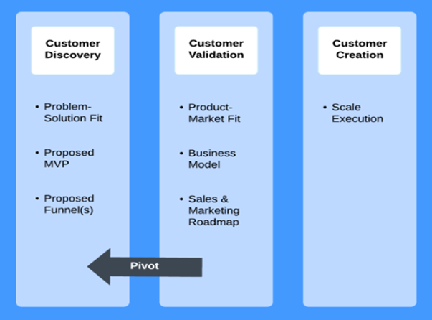
Customer Development Framework
Lean Startup methodology. (Blank S, n.d.)

Slide 7
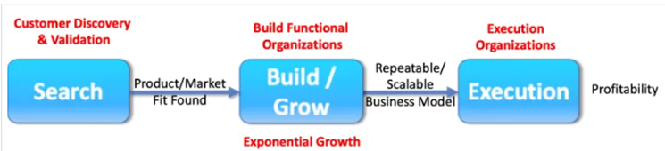
Concept of Customer Development
Customer Development framework was developed by Steve Blank as part of the
Lean Startup methodology. (Blank S, n.d.). It is part of the lean startup concept which is composed of business model design, customer development, and agile engineering.
Customer development is a framework that is used to determine whether or not a product fulfils
a need or needs of the customer. The framework, if used correctly, should result in a final product
that solves a real-world problem for the consumer, is viable to produce and scale.

Slide 8
Customer Development Process
Customer discovery : This phase focus on the understanding of customers and their needs. This may result in formulation of one or more business models, problem-solution fit, creation of inferences, hypotheses, concepts, proposed minimum viable product (MVP), problem-solution fit that can be tested.
Customer validation : This phase examines the scalability and repeatability of the viable hypotheses to meet customers need(s). This is where testing is conducted in order to assess whether or not the business model, project, or product, is viable. Typical consideration are product-market fit, scalability, feasibility, and repeatability.
Customer creation : The knowledge and information gathered from customer discovery and validation phases will enable company to develop the relevant marketing program, sales collateral to increase customer awareness and product/services demand. During this phase, company will need to develop a repeatable, scalable sales process to service growing customers and build relationship to improve customer satisfaction. Company will need to embrace customer focused activities and embark on cultivating better customer relationship management (CRM). Company may need to systemize process using tools and systems like CRM and Data Analytics

Slide 9
Benefits of Customer Development
Delays investing significant resources into building solutions until there is a proven, justifiable need for them and an assurance that the product will actually benefit the customer. With this upfront exercise, companies avoid spending money and time on products that might work versus products that should work.
Avoid making the mistake of creating a product or solution without truly testing if it’s the best approach. The rigorous validation that comes with Customer Development can remove much of the emotion from the decision-making process and allow facts and data to drive the process.
Often results in much simpler and cheaper solutions; by truly understanding the market and customer requirements, companies can focus on building what companies actually need (ranked by customer priority) instead of trying to solve every possible issue the company thinks customers care about.

Slide 10
Customer Development case example : Dropbox (1 of 4)
Background : Dropbox had a team full of great engineers, but didn’t know all that much about marketing — leading them to spend way too much on various marketing channels.
Problem : The team at Dropbox had engineering experience but almost no marketing experience to speak of. The team was taking the advice of investors and mentors and using traditional marketing methods. Yet, these traditional marketing methods were not what was causing the company to grow. Essentially, Dropbox was throwing money away on marketing channels that were not driving customers while still seeing a growth that was unexplained. Growth of any kind was good but it is hard to perpetuate that growth when it is unclear where the growth was coming from. At one point, they were spending hundreds of dollars per customer acquisition on a product that cost only $99!

Slide 11
Customer Development case example : Dropbox (2 of 4)
Customer Discovery : What Dropbox realized it had to do was go back to finding their customers. To do this, they began to work closely with the customers that Steve Blank would call “early adopters.” They worked to put code together to send out to keen engineers – people just like them. The code they sent out was far from the finished product. However, this basic presentation of the product allowed Dropbox to confirm that the problem that it was attempting to solve was very real for its customers. Through the feedback it got from early adopters, Dropbox realized it was on its way to a real solution. One of the biggest lessons that Dropbox learned during this stage was that they could not just head to the forums where its audience spent its time. They also had to communicate with these customers in an authentic way if they wanted to get real feedback.

Slide 12
Customer Development case example : Dropbox (3 of 4)
Customer Validation : Dropbox created a snapshot of their product. This was their minimum viable product. It showed the inherent value of the full product but did not include all of the bells and whistles yet. They sent this minimum viable product out to Hacker News, where their early adopters lived. The feedback they got was of very high quality. More importantly, the feedback they got validated their learning. They created a private beta launch video for their early adopters. Because they knew where their customers were and how to speak to them, the video resulted in a waiting list that grew to 75,000 people in only a single day.

Slide 13
Customer Development case example : Dropbox (4 of 4)
Customer Creation : Dropbox had its early adopters excited about its product. To stick to the Customer Development model, the company would have to begin to create its mainstream customer base. To get started, Dropbox created a landing page that was designed to capture interest before the official release of the product. This landing page was important because it gave a place for its current customers to refer their friends. Rather than driving demand through the mainstream media, Dropbox pivoted and found a way to facilitate these referrals by creating a solid landing page. Dropbox started to focus on data analysis and marketing. They also perform split tests to determine the best landing page optimizations, encourage sharing and analyze surveys. This investment in the analytics was a part of the “learn early, learn often” strategy that Dropbox had previously adopted. With all of these tools, Dropbox grew their user base from 100,000 users to four million users almost entirely through viral sharing and their word of mouth programs.
Result : Dropbox remains a very popular product and one of Silicon Valley's greatest success stories.

Slide 14
MODULE 2.
CUSTOMER DISCOVERY INTERVIEW
● Articulate your Business Model Hypotheses
● Plan and Conduct a Customer Discovery Interview

Slide 15
Customer Discovery Phase to understand customers needs
Business starts with a hypothesis in customer development
Customer Discovery phase focuses on Understand customers and their needs that company may be able to satisfy.
Companies need to talk to potential customers to gather real feedback to back own assumptions.
By listening to real needs, pain points, and opinions about existing products, companies will ensure their product or service has real value to the customers.
As Steve puts it, “Stop selling, start listening.”

Slide 16
[Activity] Discovering Needs
Starting with your own business hypothesis, find a partner to act as your potential customer & get answers on what are their pain points/ problems / needs.
Then write down the answers to the following questions:
a) Describe your partner’s pain points in your own words
b) List out the real needs and how do you think this can be solved
or aligned to your business hypothesis

Slide 17
Customer Discovery Interview
SPIN Selling process developed by Neil Rackham (SPIN Selling: The Ultimate Guide, n.d.)
The SPIN Selling process involves four key stages:
Situation Questions: The salesperson begins by asking questions to understand the prospect's current situation, needs, and challenges.
Problem Questions: The salesperson asks questions to identify the prospect's problems, challenges, and pain points.
Implication Questions: The salesperson asks questions to help the prospect understand the potential consequences of not solving their problems or addressing their challenges.
Need-Payoff Questions: The salesperson asks questions to help the prospect see the value in solving their problems or addressing their challenges, and to build momentum towards closing the sale.
Important to LISTEN to have accurate understanding of customer’s needs.

Slide 18
Recap
Customer discovery : focuses on the understanding of customers and their needs.
This result in business models, problem-solution fit, creation of inferences, hypotheses, concepts, proposed minimum viable product (MVP), problem-solution fit that can be tested.
Use information gathered in Customer discovery, participants can develop materials needed, including a business model canvas, (Business Model Canvas, n.d.) value propositions, sales collateral, and product positioning (Business Model Canvas, n.d.) to meet customers real needs.

Slide 19
MODULE 3.
CUSTOMER RELATIONSHIP MANAGEMENT (CRM)
● Understanding Customer Relationship Management
● Plan for Customer Relationship Management

Slide 20
[Activity] Sharing experiences
Activity for Participants (work in pair)
a) As Business owner, think about experiences on how to grow customers for your business
b) Share your experiences with your partner

Slide 21
Customer relationship management (CRM)
Customer relationship management (CRM) refers to a set of methodologies, tools, and practices that businesses use to manage and improve their interactions with customers. The ultimate goal of CRM is to build better relationships with customers, which can lead to increased sales, improved customer satisfaction, and long-term loyalty.
CRM is a process to manage potential and current customers and provides salesperson with systematic approach to Get, Grow and Retain customers. salesperson follow processes to improve sales potential.
CRM system automates day-to-day interactions with customers, collects customer data for business to gain insights and improve customer experiences.

Slide 22
The benefits of CRM
Automation: CRM systems can automate many routine tasks, such as lead and opportunity management, contact management, and customer service, freeing up time for employees to focus on improving relationships with customers.
Improved efficiency: By streamlining processes and automating tasks, Salesperson can improve overall efficiency and productivity, helping businesses save time and money.
Improved insights: CRM with Analytics function provide valuable insights into customer behavior and preferences, helping businesses make data-driven decisions to improve customer experiences and increase revenue.
Personalization: CRM with Analytics can help businesses create more personalized experiences for customers, increasing customer satisfaction and loyalty.

Slide 23
Benefits of CRM to Industries
As CRM collects customer centric data, businesses can leverage on Analytics to make strategic decisions, for example:
Retail: Retail businesses can gain insights into customer behavior and preferences, such as what products they buy and when they are most likely to make a purchase.
Financial services: Financial services businesses can identify trends and predict future behavior. This information can help businesses make informed decisions about lending and risk management.
Healthcare: Healthcare businesses to identify health risks and develop targeted treatment plans. This information can help healthcare providers improve patient outcomes and reduce costs.

Slide 24
CRM Process
Lead Generation: The process starts with collecting leads through various channels
Lead Management: Then manage and qualify them based on criterias eg BANT
Sales Process: Qualified leads are passed to sales team to start sales process.
Opportunity Management: Leads created and move through various stages of the sales process.
Account Management: Customer is onboarded, and managed, nurture to increase loyaltyupselling and cross-selling.
Analytics and Reporting: Throughout the process, data is collected, analyzed, and reported to measure the success of the CRM process and to make data-driven decisions.

Slide 25
LEAD GENERATION
Step 1 : Lead Generation
The process starts with collecting leads through various channels such as social media, email campaigns, and advertising. (e.g company name, website, telephone, email, social media…)

Slide 26
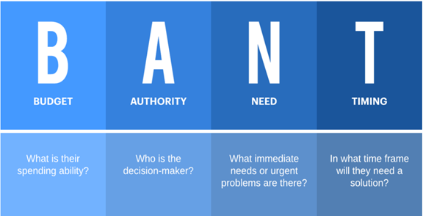
LEAD MANAGEMENT
Step 2 : Lead Management
Once the leads are generated, the next step is to manage and qualify them based on criteria such as budget, authority, need, and timing (BANT) (Lucidchart, 2022)
https://www.lucidchart.com/blog/what-is-BANT-and-how-can-it-streamline-lead-qualification

Slide 27
SALES PROCESS, OPPORTUNITY MANAGEMENT AND
ACCOUNT MANAGEMENT PROCESS
Managing a sales pipeline using leads and opportunities is one of key functions of CRM
Step 3 Sales Process : The qualified leads are then passed on to the sales team, who will engage, answer queries, and provide product/service demos.
Step 4 Opportunity Management : Sales team create opportunity for interested leads and move lead through various stages of the sales process pipeline i.e. Qualify, Develop, Propose, Close
Step 5 Account Management : After deal is closed, customer is onboarded, account is managed, nurtured via Identify, Plan, Execute, Review, providing post-sales support, and identifying opportunities for upselling and cross-selling

Slide 28
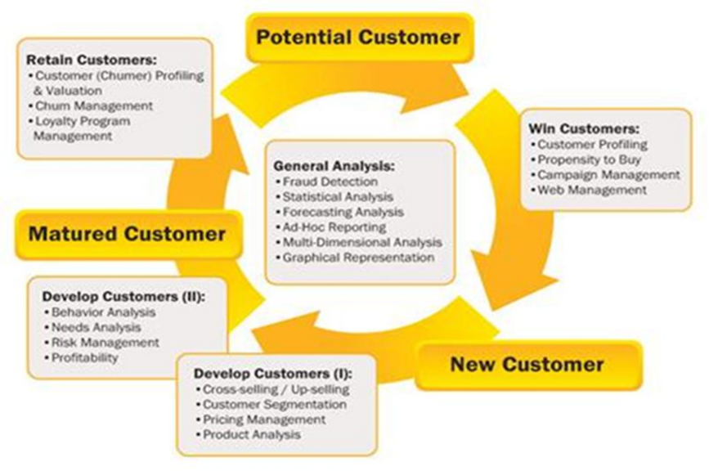
ANALYTICS & REPORTS
Step 6 : Analytics and Reporting
Examples of Automated Analytics to derive insights in different stages of customer’s life cycle
Copyright © Integral Solutions (Asia) Pte Ltd, 2022

Slide 29
Manual Analytics vs Automated Analytics
Differences between Manual and Automated Analytics:
Manual Analytics depends on users to pre-select parameters/dimension. This is usually presented as static reports or Business Intelligence dashboards as information
Automated Analytics leverages Artificial Intelligence (AI) to discover patterns and target segments from data automatically. This often results in insights which may be missed by users and pre-selected dimensions
Automated Analytics are used to increase effectiveness of target marketing, discover new customer segmentation to increase revenue, predict next purchase items, discover up sell opportunities to increase profitability, discover customer lifetime value and increase customer loyalty.

Slide 30
Recap
CRM provides a systematic approach to Get, Grow and Retain customers enabling businesses to build and maintain relationship with customers
Is a systematic approach to do Lead Generation, Lead Management, Sales ProcessOpportunity Management, Account Management, Analytics and Reporting
Throughout the process, data is collected, analyzed, and reported to measure the success of the CRM process and to make data-driven decisions
A well-designed CRM plan can help businesses accomplish better customer relationships, Improved support, Improved efficiency

Slide 31
[Activity] CRM discussion
a) Share your direct/indirect experiences regarding the customer relationships in your businesses.
b) Share your plan on how to improve or execute CRM for your business.

