Slide 1



E-Business Training Content For Trainers

Slide 2


Digital Marketing Advanced
MS-301
Fani Pramuditya

Slide 3
MODULE 2.
Content Marketing

Slide 4

2-1. [Activity]
Sharing Perception of Content Marketing
The trainer asks the participants to present their perception of content marketing. Participants are encouraged to share their perspectives on content marketing.
The instructor can ask 2-3 participants and each person has 1 minute to answer.
For example, the instructor can play a video showing viral advertising on social media (each country might have a different example of a video which popular in every country)

Slide 5
2-2.
What is Content Marketing?
  Content marketing is a marketing and business process for creating and distributing relevant content to attract, acquire, and engage a clearly defined and understood target audience with the objective of driving profitable customer action (Rose, 2013).
  The key to content marketing is valuable content.
  Content marketing examples: blogs, newsletters, whitepapers, videos, email, social media posts, etc.

Slide 6







Content Marketing Examples

Slide 7
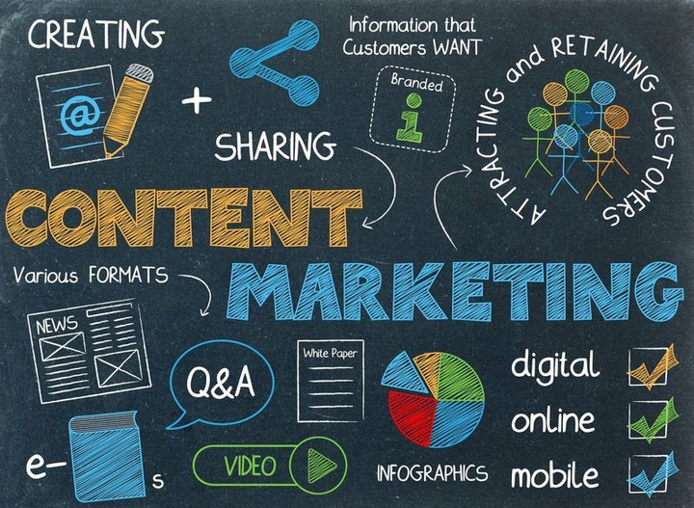
2-3.
Why Content Marketing?
  Content marketing is crucial because it helps you build trust, develop connections, enhance conversions, and generate leads by answering your audience's questions.
  Consistent, high-quality, and engaging content drives audience decision-making more than any other strategy.

Slide 8





Increased your sales and cost- saving.
2-4.
The Benefits of Content Marketing
Better customers with greater loyalty.
Better traction on social media.
Original content can improves conversions.
Brands build name awareness.

Slide 9
2-5.
The Stages of Content Marketing
Consideration stage
Awareness stage
Closing stage
Your content should focus on the top concerns of your audience. Writing about their problems, difficulties, and concerns provides you the best chance of engaging with them.
Articles, blog entries, e-books, videos, and newsletters are excellent choices for this stage.
Content in the consideration stage should include a mix of useful information and promotion. Your content should be oriented toward what your business has to offer.
Case studies, how-to articles, how-to videos, and checklists or worksheets are ideal for this stage.
You can emphasize sales as long as you continue to highlight why you're the greatest option. Your main message should be your expertise, knowledge, and the unique benefits of what you sell.
Case studies, user-generated content, a buyer's guide, and a product film are good options for this stage.

Slide 10
2-6.
The Types and Channels for Content Marketing
Attraction, authority, affinity, and action are the content categories used in content creation and marketing. It is crucial to remember that the content categories are not mutually exclusive and that a single piece of content can fit into numerous categories.

Slide 11
The Types of Content Marketing
The Channels of Content Marketing
  Infograpics
  Whitepapers and e-Books
  Video Content
  Podcasts
  Websites
  Blogs
  Case studies
  Interactive content
  Social media
  User-Generated Content

Slide 12
2-7.
Content Marketing Strategy
  Content marketing's goal is to grow, engage, and retain your audience.
  Content marketing strategy is all about creating and distributing content to grow your audience.
The benefits of a content marketing plan:
  More online visibility
  More leads
  More authority
  More customer engagement
  More budget

Slide 13
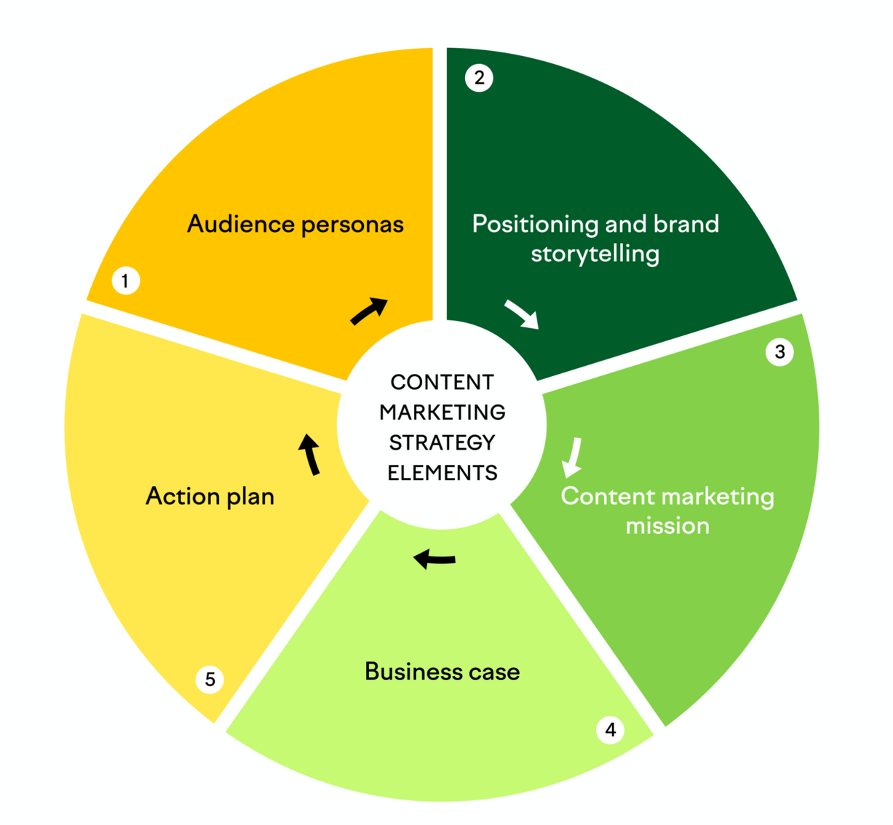
2-8.
Five Core Elements of Content Marketing Strategy

Slide 14

2-9.
(1) Audience Personas
Identify the audience you like to target. Here are a few tips to do that:
  Survey your existing customers
  Research the latest trends
  Identify whom you do not want to target
  Keep track of whom your competitors are targeting

Slide 15

2-10.
(2) Brand Story and Positioning
Summary of your business's history, mission, purpose, and values.
Your story should focus on:
  The hero of your story (your customer) and their goals and challenges
  Your brand’s personality
  The purpose of your brand and key brand values
  Your product or service, as well as your content, can help to reinforce all of the above and empower your hero.

Slide 16

2-11.
(3) Content Marketing Mission
Define your owned media value proposition to build your brand as a trustworthy content creator.
Make sure your content marketing mission statement has the following components:
  Your audience: Who are you creating content for?
  The benefit: What information or answer will you provide
  The outcome: How will your content help your audience achieve their goals?

Slide 17

2-12.
(4) Business Case
  Creating a business case will help you better understand the benefits, costs, and risks of implementing a content marketing strategy in your company.
  A project management document that explains why specific tasks should be completed and how the benefits exceed the costs.

Slide 18

2-13.
(5) Action Plan
Include your main marketing campaigns and projects in your content plan.
On planning your content, make sure to include the following:
  Select content topics for each campaign.
  Determine which content types you will produce.
  Choose the distribution channels for your material.

Slide 19
Content marketing is a strategy used to attract, engage, and retain audiences by creating and sharing relevant articles, videos, infographics, podcasts, and other media.
The five core elements of content marketing strategy:
  Audience personas
  Positioning and brand storytelling
  Content marketing mission
  Business case
  Action plan
2-14.
Recap

Slide 20

2-15. [Activity]
Discussing Content Marketing
  Share your direct and indirect experiences with content marketing in your business.
  Share your ideas regarding how to design and improve your content marketing strategy for your businesses.
The instructor asks the participants to form discussion groups (4 – 7 members per group). Considering the similarity of the [intended] businesses, the instructor needs to prepare a guide to form the discussion groups.

Slide 21
Thank You!

